Slide 1

Provide Insights For Telangana Government Tourism Department
Presented by:
MASNA
Data Scientist

Slide 2
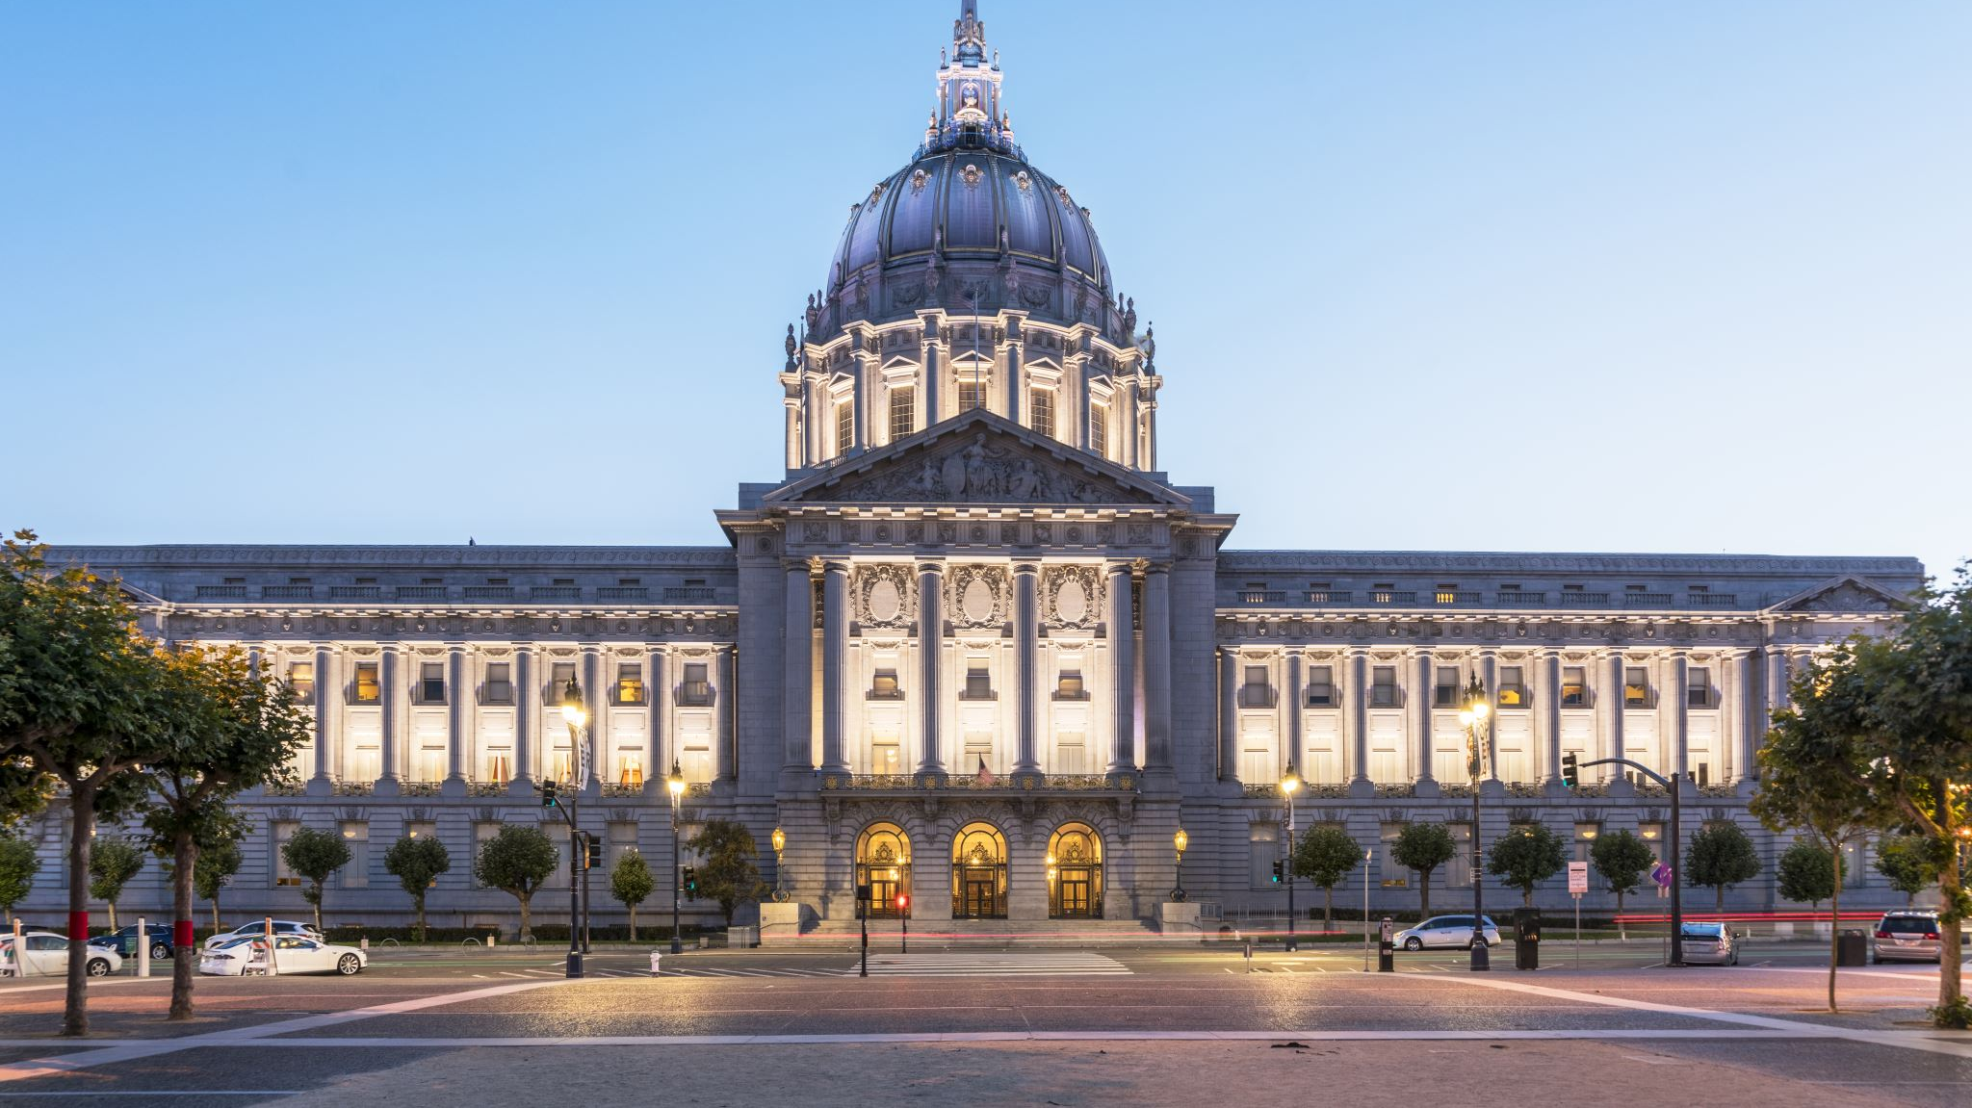
Overview of the project
The Telangana Government Tourism Department is responsible for promoting and developing tourism in the Indian state of Telangana. Its main objectives are to attract tourists to Telangana, create tourism infrastructure, and develop new tourism products. The department offers a variety of tourism services and facilities such as accommodation, transportation, and tour packages. It also organizes various events and festivals throughout the year to showcase the state's culture and heritage.

Slide 3
Contents
Preliminary Research Questions: (Answers can be found dire...
Secondary Research Questions: (Need to do research and ge...
Recommendations To the government

Slide 4
Preliminary Research Questions: (Answers can be found directly from the given data)
1 . List down the top 10 districts that have the highest number of domestic visitors overall (2016-2019)?
3.List down the bottom 3 districts based on compounded an...
4.What are the peak and low season months for Hyderabad b...
5.Show the top & bottom 3 districts with high domestic to...
2.List down the top 3 districts based on compounded annual...

Slide 5
1 . List down the top 10 districts that have the highest number of domestic visitors overall (2016-2019)?

Slide 6
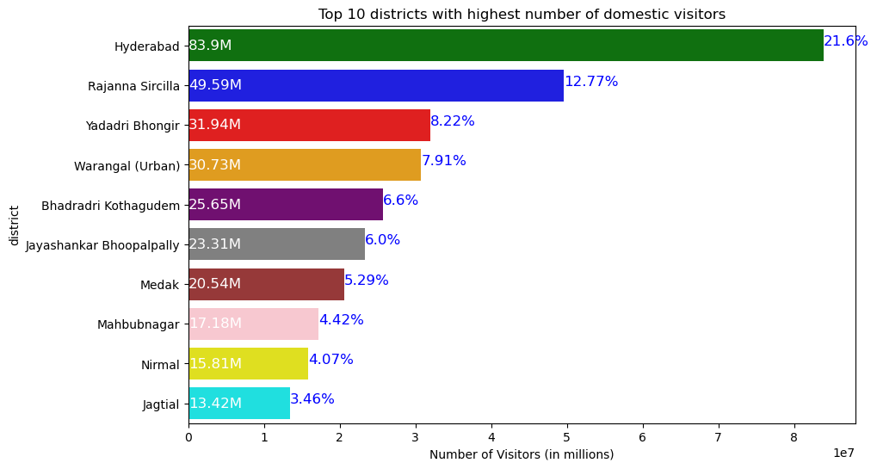
the top 10 districts that have the highest number of domestic visitors overall (2016-2019)?
The district Hyderabad has the highest number of visitors(around 83.9 million), which accounts for 21.6% of the total number of visitors to all districts.
The graph also shows that the remaining districts have a comparatively lower number of visitors to the top two districts
Hyderabad followed by Rajanna Sircilla are the most popular districts for domestic visitors in Telangana

Slide 7
2.List down the top 3 districts based on compounded annual growth rate (CAGR) of visitors between (2016 - 2019)? (Insight: Districts that are growing)

Slide 8
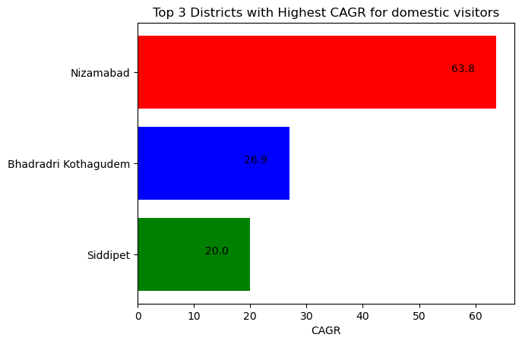
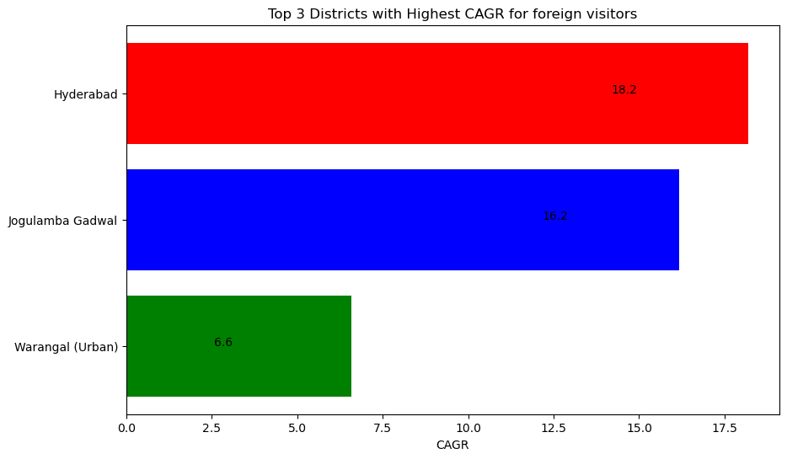
top 3 districts based on compounded annual growth rate (CAGR) of visitors between (2016 – 2019)
To calculate the compounded annual growth rate (CAGR) of visitors for each district, we can use the following formula: CAGR = ((EV / BV) ^ (1/n)) - 1 where EV = Ending Value, BV = Beginning Value, and n = number of years.

Slide 9
Top 3 districts based on compounded annual growth rate (CAGR) of Domestic visitors between (2016 - 2019) There was a significant increase in the number of visitors of Nizamabad from 2017.This suggests that Nizamabad along with Bhadradri Kothagudem and Siddipet has the potential to attract more domestic tourists in the future as well
District with highest CAGR of Domestic Visitors
District | 2016 | 2017 | 2018 | 2019 | CAGR
Nizamabad | 6442 | 21949 | 41423 | 46333 | 63.76362
Bhadradri Kothagudem | 4939210 | 4094317 | 3799878 | 12817737 | 26.92246
Siddipet | 1441262 | 1145721 | 1283300 | 2987864 | 19.9926

Slide 10
Top 3 districts based on compounded annual growth rate (CAGR) of Foreign visitors between (2016 - 2019) Hyderabad has the highest number of foreign visitors in all four years comparatively to any other district, with a significant increase from 163,631 in 2016 to 319,300 in 2019. This indicates that Hyderabad is a popular destination for foreign visitors in the state
District with highest CAGR of Foreign Visitors
district | 2016 | 2017 | 2018 | 2019 | CAGR
Hyderabad | 163631 | 247179 | 314788 | 319300 | 18.19071
Jogulamba Gadwal | 162 | 305 | 300 | 295 | 16.16539
Warangal (Urban) | 1899 | 2630 | 1842 | 2450 | 6.576212

Slide 11
3.List down the bottom 3 districts based on compounded annual growth rate (CAGR) of visitors between (2016 - 2019)? (Insight: Districts that are declining)

Slide 12
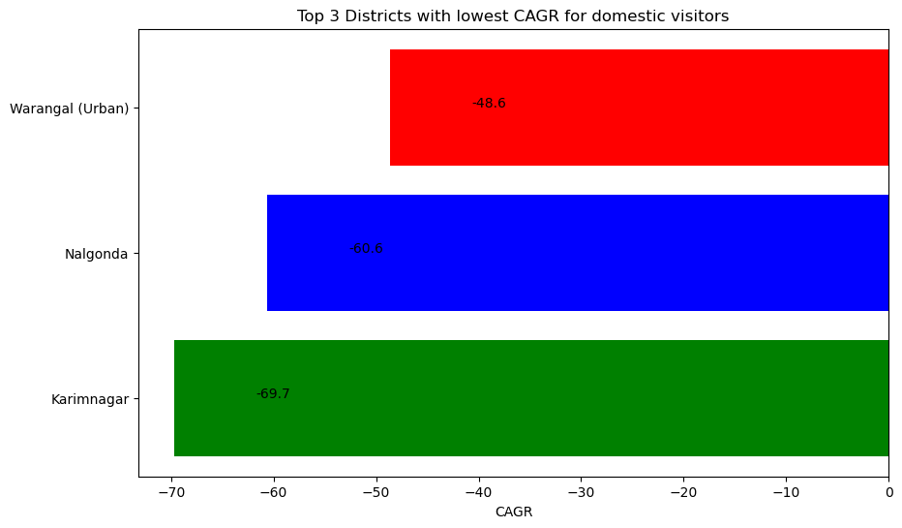
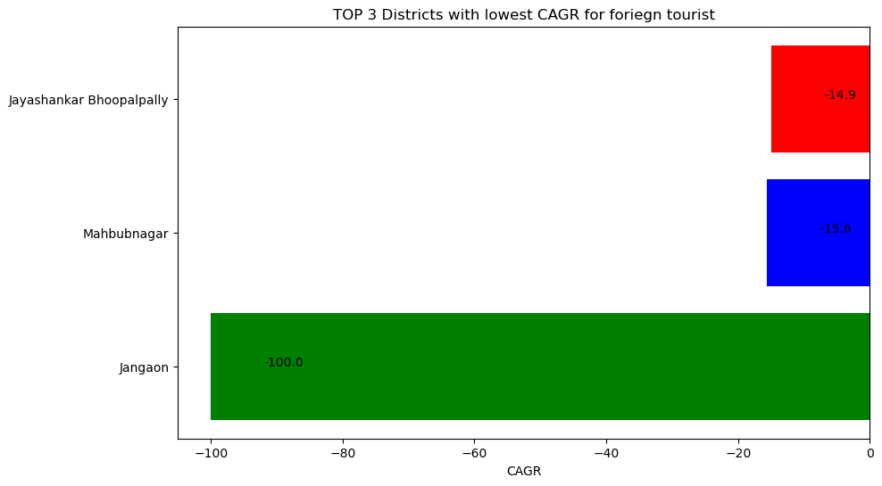
the bottom 3 districts based on compounded annual growth rate (CAGR) of visitors between (2016 - 2019)? (Insight: Districts that are declining)
Negative growth rates, which is a cause for concern for the tourism industry in these areas.
Promote tourism them through advertisements, social media, and other marketing channels.
Enhance safety measures and provide better security to ensure that tourists feel safe while visiting these places.
Develop tourism packages keeping in mind both Domestic and Foreign tourist and Organize local festivals, exhibitions by promote local culture and heritage

Slide 13
The bottom 3 districts based on CAGR of Domestic visitors between (2016 - 2019)?(Insight: Districts that are declining).
District with lowest CAGR(Domestic)
district | 2016 | 2017 | 2018 | 2019 | CAGR
Karimnagar | 9167468 | 123976 | 93448 | 77491 | -69.6785
Nalgonda | 5858461 | 241916 | 160638 | 140918 | -60.6182
Warangal (Urban) | 25788035 | 1420002 | 1723336 | 1795230 | -48.634

Slide 14
The bottom 3 districts based on CAGR Foreign of visitors between (2016 - 2019)?(Insight: Districts that are declining). These districts may need to take steps to attract more foreign visitors and improve their tourism industry. Also noted that district like Bhadradri Kothagudem where CAGR for Domestic tourism is 26.92 is not attracting any foreign tourism
District with lowest CAGR(Foriegn)
district | 2016 | 2017 | 2018 | 2019 | CAGR
Jangaon | 2 | 0 | 0 | 0 | -100
Mahbubnagar | 868 | 520 | 454 | 440 | -15.6212
Jayashankar Bhoopalpally | 86 | 582 | 539 | 45 | -14.9492

Slide 15
4.What are the peak and low season months for Hyderabad based on the data from 2016 to 2019 for Hyderabad district? (Insight: Government can plan well for the peak seasons and boost low seasons by introducing new events)

Slide 16
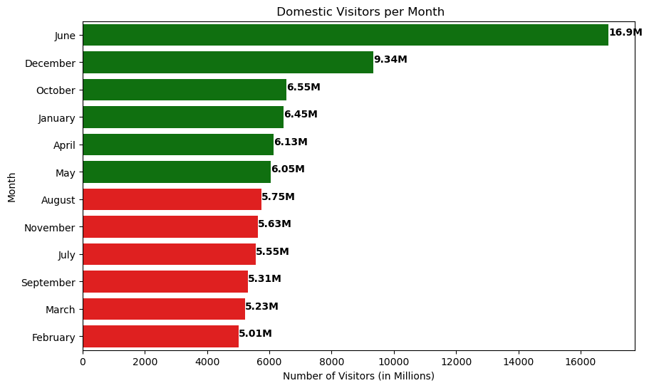
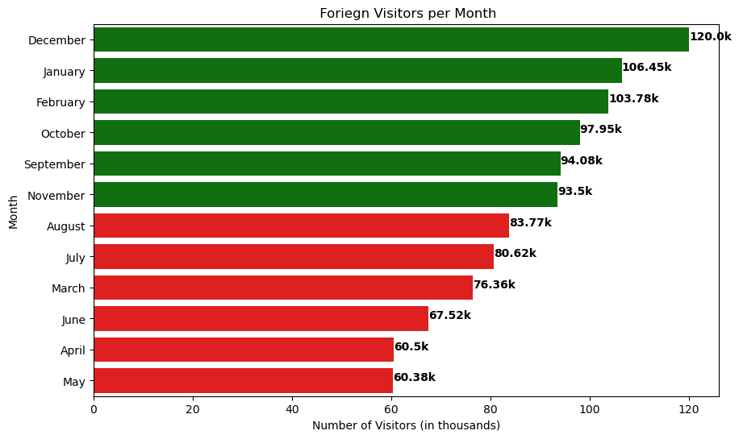
peak and low season months for Hyderabad based on the data from 2016 to 2019 for Hyderabad district? (Insight: Government can plan well for the peak seasons and boost low seasons by introducing new events)

Slide 17
Peak and low season months for Hyderabad based on the data from 2016 to 2019 for Hyderabad district for Domestic Visitors.
Number of Domestic visitors
month | visitors | percentage
June | 16897783 | 20.14
December | 9338637 | 11.13
October | 6552397 | 7.81
January | 6452101 | 7.69
April | 6126839 | 7.3
May | 6049214 | 7.21
August | 5750967 | 6.85
November | 5626156 | 6.71
July | 5552527 | 6.62
September | 5312283 | 6.33
March | 5227626 | 6.23
February | 5014430 | 5.98

Slide 18
Peak and low season months for Hyderabad based on the data from 2016 to 2019 for Hyderabad district for Foreign Visitors.
Number of Domestic visitors | Foreign visitors
month | visitors | percentage
December | 119995 | 11.48
January | 106450 | 10.19
February | 103778 | 9.93
October | 97954 | 9.37
September | 94080 | 9
November | 93503 | 8.95
August | 83769 | 8.02
July | 80616 | 7.72
March | 76358 | 7.31
June | 67524 | 6.46
April | 60495 | 5.79
May | 60376 | 5.78

Slide 19
5.Show the top & bottom 3 districts with high domestic to foreign tourist ratio? (Insight: Government can learn from top districts and replicate the same to bottom districts which can improve the foreign visitors as foreign visitors will bring more revenue)

Slide 20
the top & bottom 3 districts with high domestic to foreign tourist ratio? (Insight: Government can learn from top districts and replicate the same to bottom districts which can improve the foreign visitors as foreign visitors will bring more revenue)
Bottom 3 districts with high domestic to foreign tourist ratio
district | visitors_domestic | visitors_foreign | domestic_to_foreign_ratio
Nirmal | 15812504 | 2 | 7906252
Jangaon | 981206 | 2 | 490603
Adilabad | 7321575 | 32 | 228799.2
Top 3 | district with high domestic to foreign tourist ratio
district | visitors_domestic | visitors_foreign | domestic_to_foreign_ratio
Mulugu | 1971450 | 575 | 3428.608696
Warangal (Rural) | 972747 | 306 | 3178.911765
Hyderabad | 83900960 | 1044898 | 80.29583749

Slide 21
Secondary Research Questions: (Need to do research and get additional data)
6.List the top & bottom 5 districts based on 'population ...
8.Estimate the projected revenue for Hyderabad in 2025 ba...
2.List down the top 3 districts based on compounded annual...

Slide 22
6.List the top & bottom 5 districts based on 'population to tourist footfall ratio*' ratio in 2019? ( * ratio: Total Visitors / Total Residents Population in the given year)

Slide 23
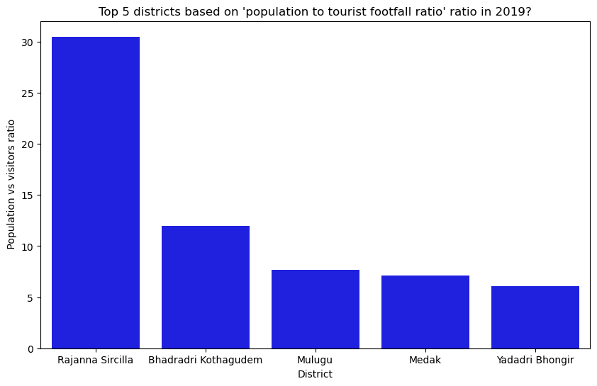
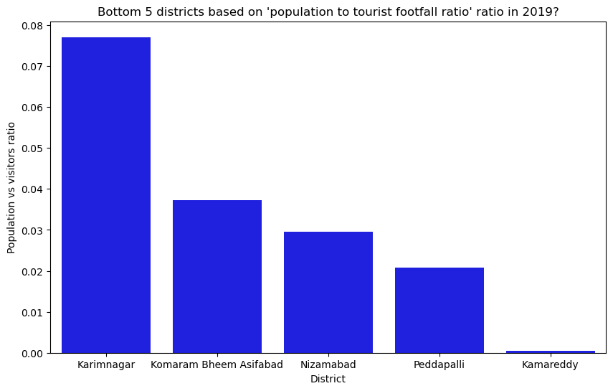
the top & bottom 5 districts based on 'population to tourist footfall ratio*' ratio in 2019? ( * ratio: Total Visitors / Total Residents Population in the given year) Population to tourist footfall ratio is a measure of how many visitors a district or region receives in comparison to its resident population. It is calculated by dividing the total number of visitors by the total resident population in a given year. This ratio can be used to assess the level of tourism activity in a particular area and its impact on the local population. A higher ratio may indicate a greater reliance on tourism for the local economy, while a lower ratio may suggest a lower level of tourism activity.

Slide 24
7.What will be the projected number domestic and foreign tourists in Hyderabad in 2025 based on the growth rate from previous years? (Insight: Better estimate of incoming tourists count so that government can plan the infrastructure better)

Slide 25
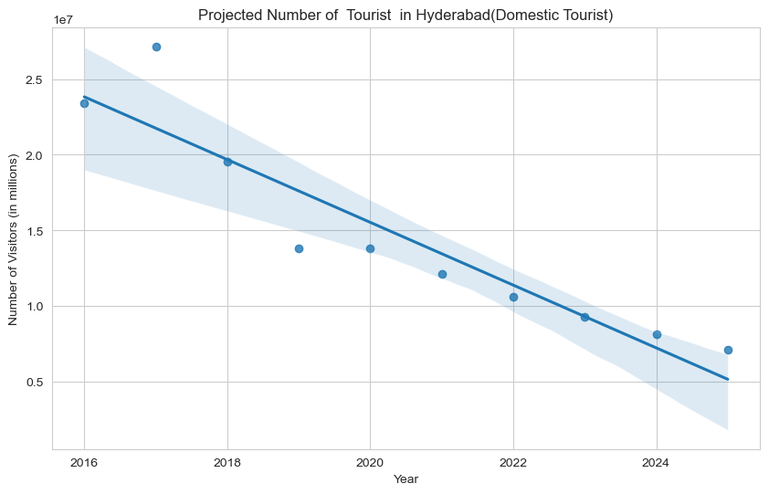
the projected number of Domestic tourists in Hyderabad in 2025 based on the growth rate from previous years?
Projected number of Domestic Visitors
Year | Projected Visitors
2016 | 23394705
2017 | 27160242
2018 | 19543651
2019 | 13802362
2020 | 13802362
2021 | 12096574
2022 | 10601598
2023 | 9291382
2024 | 8143090
2025 | 7136713

Slide 26
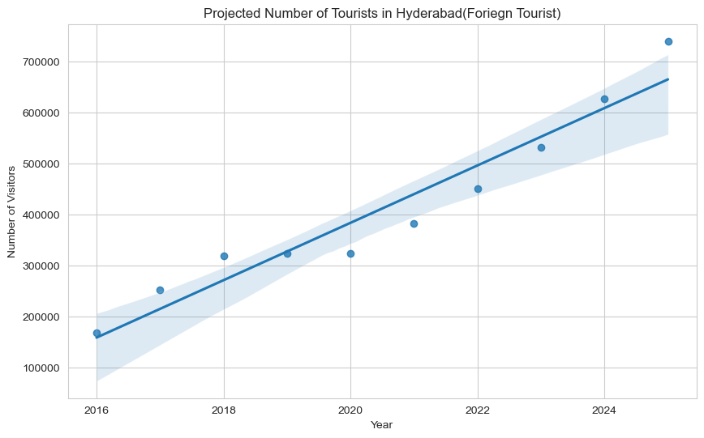
7.What will be the projected number of foreign tourists in Hyderabad in 2025 based on the growth rate from previous years?
Projected number of Foriegn Visitors
Year | Projected Visitors
2016 | 166813
2017 | 251846
2018 | 318154
2019 | 323326
2020 | 323326
2021 | 381498.9
2022 | 450138.3
2023 | 531127.4
2024 | 626688
2025 | 739441.9

Slide 27
8.Estimate the projected revenue for Hyderabad in 2025 based on average spend per tourist (approximate data) Consider Average Revenue for Foreign Tourist as Rs.5,600.00 and for Domestic Tourist as Rs.1200

Slide 28
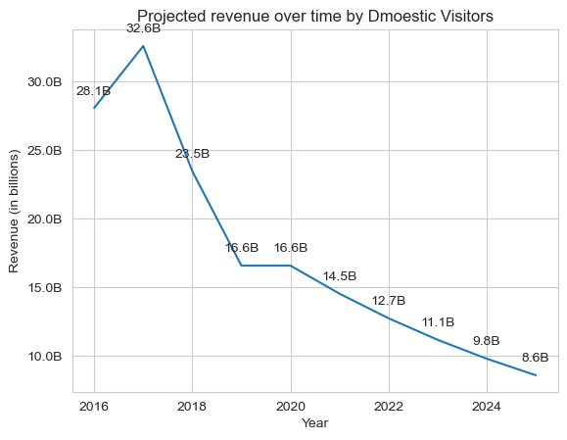
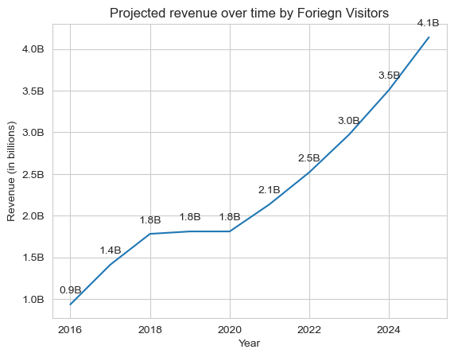
the projected revenue for Hyderabad in 2025 based on average spend per tourist (approximate data) ConsiderING Average Revenue for Foreign Tourist as Rs.5,600.00 and for Domestic Tourist as Rs.1200

Slide 29
Recommendations To the government
Districts with highest potential a. Which districts has t...
11.Dubai has made itself a business hub and enjoys massiv...
10. Cultural / Corporate Events to boost tourism a)What k...
Provide all other recommendations that can boost the tela...

Slide 30
Districts with highest potential a. Which districts has the highest potential for tourism growth and what actions government can take?

Slide 31
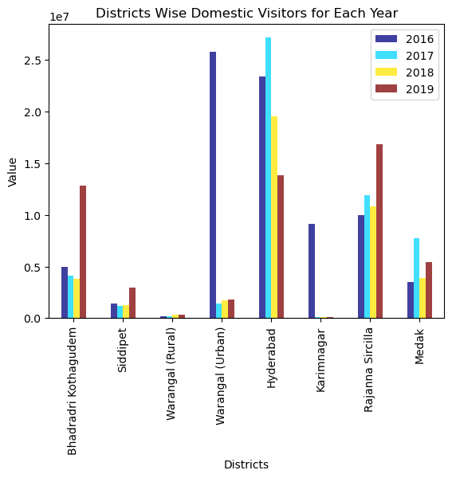
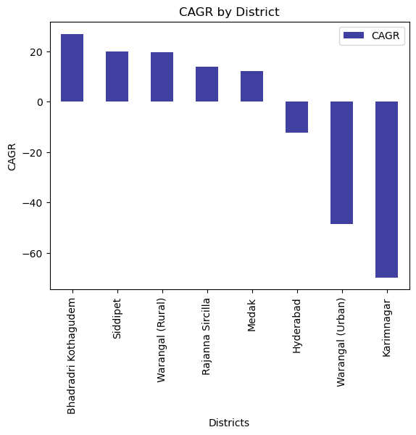
Some district are having positive CAGR and some with negative CAGR. For district with positive CAGR DESIGN AND PLAN POLICIES SO THAT THERE WILL BE INCCREASE IN THE VISITORS IN THE CONSECUTIVE YEARS ASWELL. WHEREAS FOR THE DISTRICT WITH NEGATIVE CAGR NEEDS TO HAVE COMMITTEE TO STUDY THE REASONS FOR THE DECLAIN AND THEN TAKE APPROPRIATE ACTIONS

Slide 32
10. Cultural / Corporate Events to boost tourism a)What kind of events the government can conduct? B)Which month(s)? C)Which districts?

Slide 33
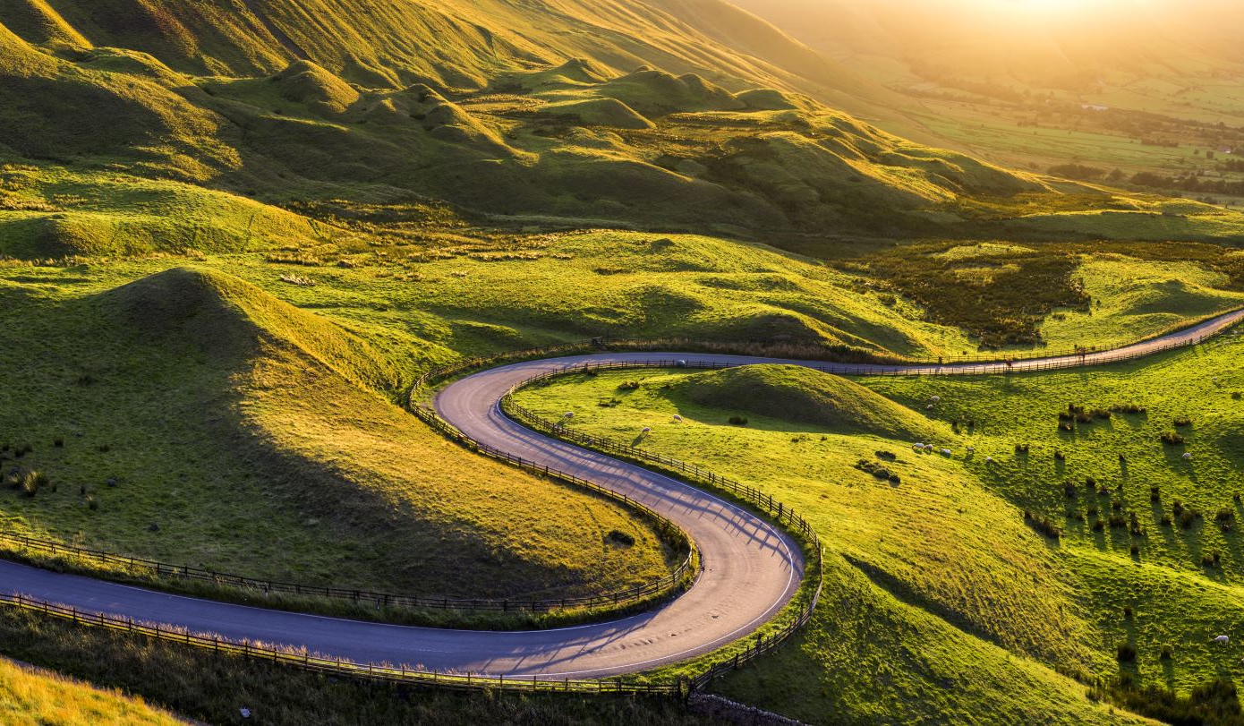
a)What kind of events the government can conduct?
Telangana is famous for its rich history, culture, and cuisine
Develop and promote heritage tourism and generate revenue for the local economy.
Promote culinary tourism to attract foodies and travelers interested in trying new and authentic dishes, and create opportunities for local food businesses.
Organize cultural events throughout the year.
Develop adventure tourism activities, such as trekking, camping, and rock climbing, can help attract adventure seekers and outdoor enthusiasts, and generate revenue for local businesses.
Enhance tourism infrastructure: Improving tourism infrastructure, such as transportation, accommodation, and tourist facilities, can help attract more visitors and create a better tourism experience.

Slide 34

Which month(s) BEST SUITED FOR TOURISM
The choice of month(s) for conducting events depends on various factors such as weather conditions, cultural significance, and availability of tourists.
For example, events can be conducted during the winter season from November to February when the weather is pleasant and conducive to outdoor activities.
According to the given data tourism activities are more from the month of July to February.
Additionally, events can be scheduled around cultural festivals and holidays to attract more tourists.

Slide 35
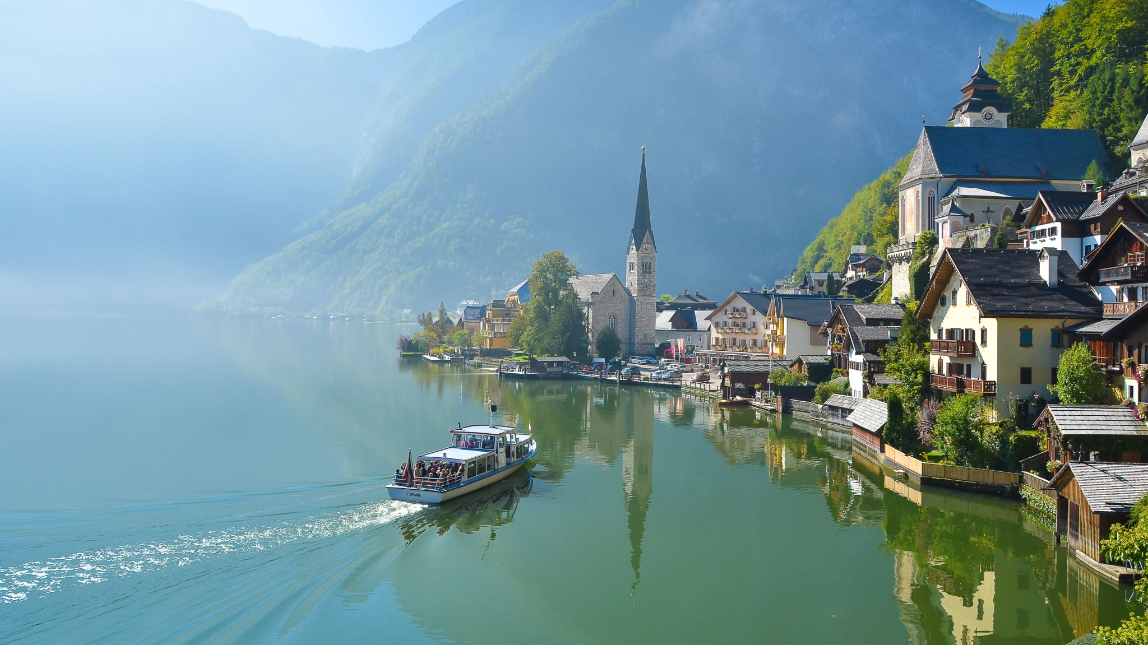
C)Which districts TO BE GIVEN MORE IMPORTANCE FOR DEVELOPING TOURISM
Telangana has a rich cultural and historical heritage, as well as natural beauty that make it an attractive tourist destination. The state offers a range of tourist attractions that showcase its unique history, culture, and cuisine.
Here are some of the best tourist destinations in Telangana: Hyderabad ,the capital city of Telangana is home to famous landmarks like the Charminar, Golconda Fort, and the Chowmahalla Palace.
Warangal, is known for its beautiful lakes, temples, and forts can attract most number of tourists.
Adilabad district in Telangana is famous for its beautiful waterfalls, rich tribal culture, and historic landmarks.
Karimnagar district in Telangana is famous for its historical monuments, also renowned for its handloom industry, which produces exquisite handwoven saris and dress materials.
Districts like Medak, Nizamabad , Khammam ,Mahbubnagar, Nalgonda famous for its historical landmarks and religious sites. Rangareddy is known for its historic landmarks also a popular destination for adventure sports, such as trekking, rock climbing, and parasailing.
So develop tourism plan for each district based on the significance and scope.

Slide 36
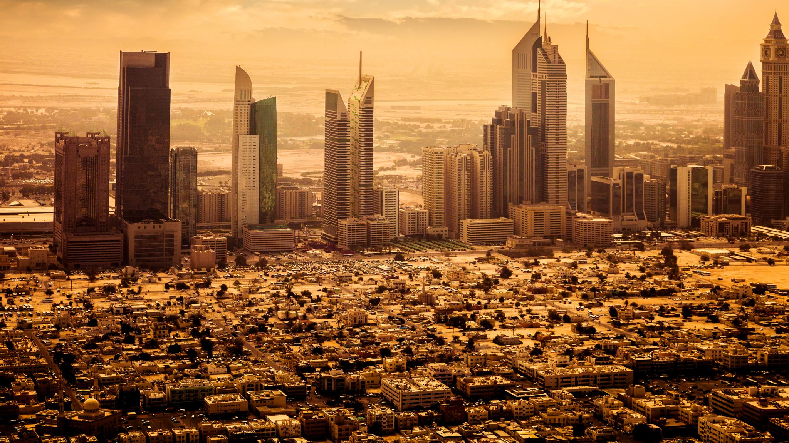
11.Dubai has made itself a business hub and enjoys massive business tourism. Can Hyderabad emulate the Dubai model? Provide insights based on your research.

Slide 37
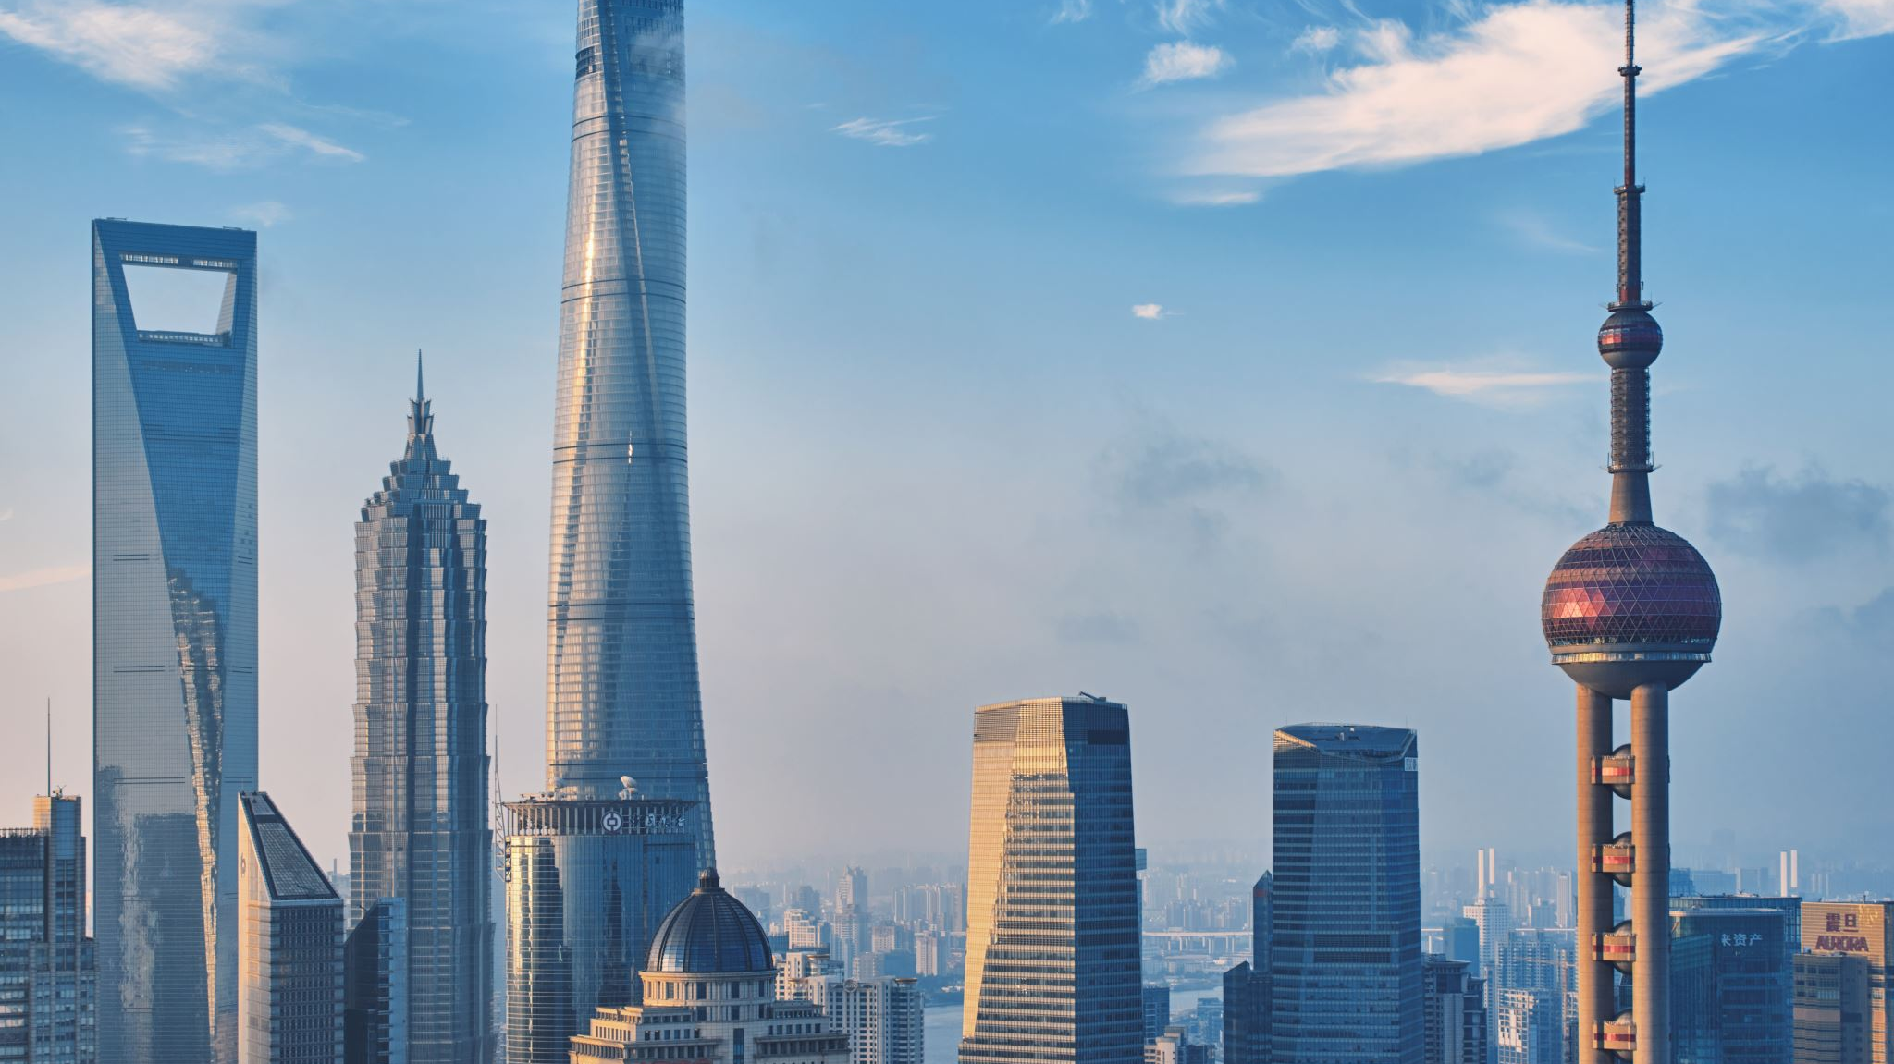
DUBAI VS HYDERABAD
Dubai has established itself as a major business and tourism hub due to its strategic location, world-class infrastructure, and favorable economic policies. It has a highly developed transportation system including a network of highways, ports, and railways that connect it to other major cities in the region. Dubai also has a favorable tax system, which attracts foreign investors and businesses. They have recently introduced different Visa Policies like “Golden visa” in order to attract maximum investments to the country.
Hyderabad, on the other hand, has emerged as a major IT hub in India due to its large pool of skilled workers, low cost of living, and favorable government policies. It has a growing startup ecosystem, with many new companies being established in the city each year. Dubai has invested heavily in developing its infrastructure, including building some of the world's tallest buildings and most luxurious hotels, as well as creating world-class attractions such as the Burj Khalifa and Dubai Mall. In contrast, Hyderabad is still in the process of developing its infrastructure and attracting more international businesses and tourists.s
Overall, while Hyderabad has the potential to become a major business and tourism hub in the region, it will require significant investment and development to reach the level of Dubai. However, with the right policies and investments, Hyderabad can continue to grow and develop its economy, and become a major player in the global business and tourism industries.

Slide 38
Provide all other recommendations that can boost the telangana tourism, particularly Hyderabad.

Slide 39

recommendations To boost the telangana tourism, particularly Hyderabad.
Increase funding for tourism: Increase the budget allocation for tourism promotion, infrastructure development, and other related initiatives. This will help to improve the quality of tourism services and attract more visitors.
Encourage private investment: Encourage private sector investment in tourism infrastructure, such as hotels, resorts, and other tourist facilities. The government can offer incentives and tax breaks to investors to make it more attractive to invest in the tourism sector.
Promote sustainable tourism: Promote sustainable tourism practices that minimize the negative impact on the environment and local communities. This includes encouraging responsible tourism practices, such as reducing waste and supporting local businesses.
Develop niche tourism products: Develop and promote niche tourism products, such as cultural and heritage tourism, adventure tourism, and eco-tourism. This will help to attract different types of tourists and diversify the state's tourism offerings.
Improve connectivity: Improve connectivity within the state by investing in transportation infrastructure such as airports, roads, and railways. This will make it easier for tourists to travel within the state and access different tourism destinations.
Simplify visa procedures: Simplify visa procedures to make it easier for tourists to visit the state. This will help to attract more international visitors and boost the tourism industry.
Support tourism training and education: Support tourism training and education programs to improve the quality of the tourism workforce and promote professional development in the industry.
Use digital technology: Utilize digital technology to promote tourism and make it easier for tourists to plan their trips and access tourism information. This includes developing mobile apps, online booking platforms, and social media marketing.

Slide 40

Thank you

